Slide 1
Amazon Sales Data Analysis
Detailed Project Report
Gautam Vora

Slide 2
PROJECT DETAIL
Project Title | Amazon Sales Data Analysis
Domain name | E-Commerce
Project Difficulties Level | Project Difficulties Level Advanced
Tools | Jupyter notebook, , Ms Excel, Ms PowerPoint,python.

Slide 3
O B J E C T I V E
Extract-Transform-Load some Amazon dataset and find
Sales-trend -> month wise , year wise , yearly_month wise

Slide 4
PROBLEM STATEMENT
• Sales management has gained importance to meet increasing competition and the need
• for improved methods of distribution to reduce cost and to increase profits. Sales
• management today is the most important function in a commercial and business
• enterprise.
• Do ETL : Extract-Transform-Load some Amazon dataset and find for me
• Sales-trend -> month wise , year wise , yearly_month wise
• Find key metrics and factors and show the meaningful relationships between attributes

Slide 5
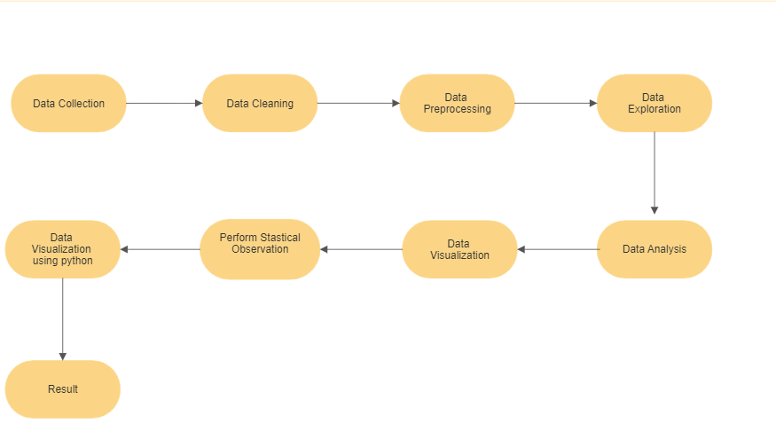
ARCHITECTURE

Slide 6
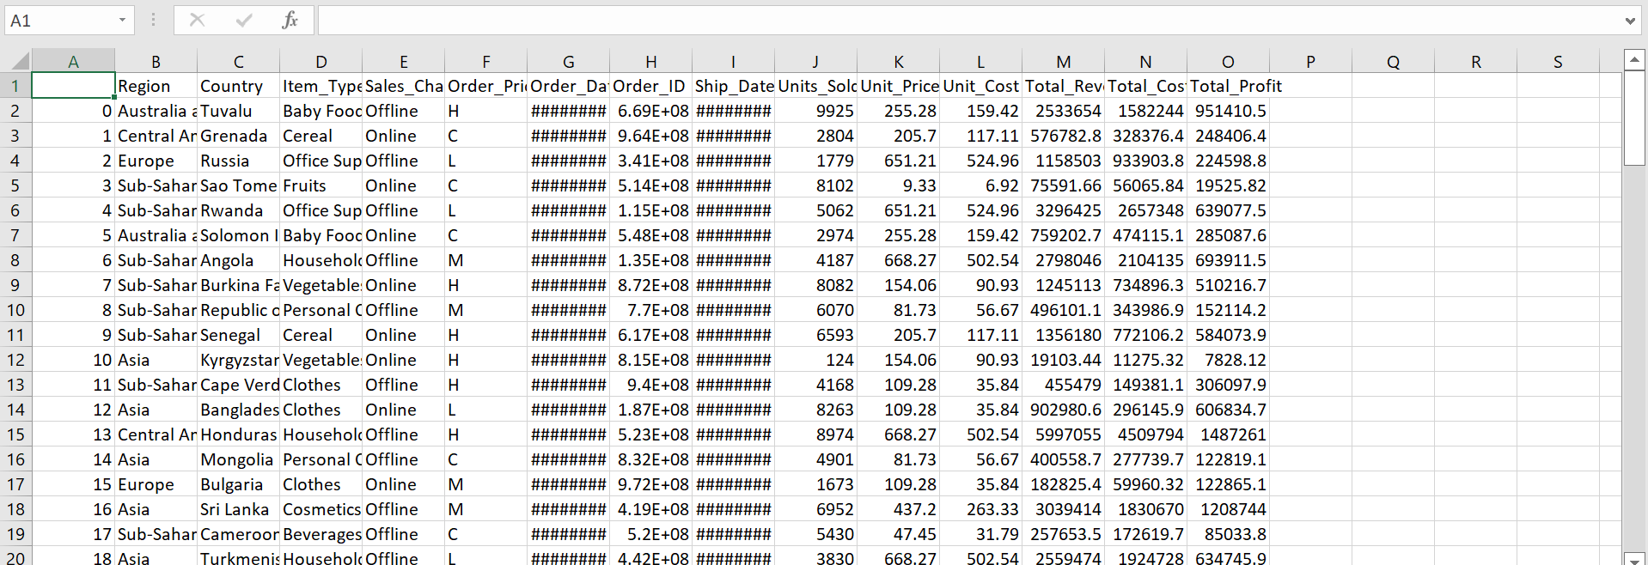
DATASET INFORMATION
The Dataset is taken from iNeuron’s provided dataset-
https://drive.google.com/drive/folders/1FkmFVL8wlJmQWP1z52TD8PlhOJhitTyI?usp=sharing

Slide 7
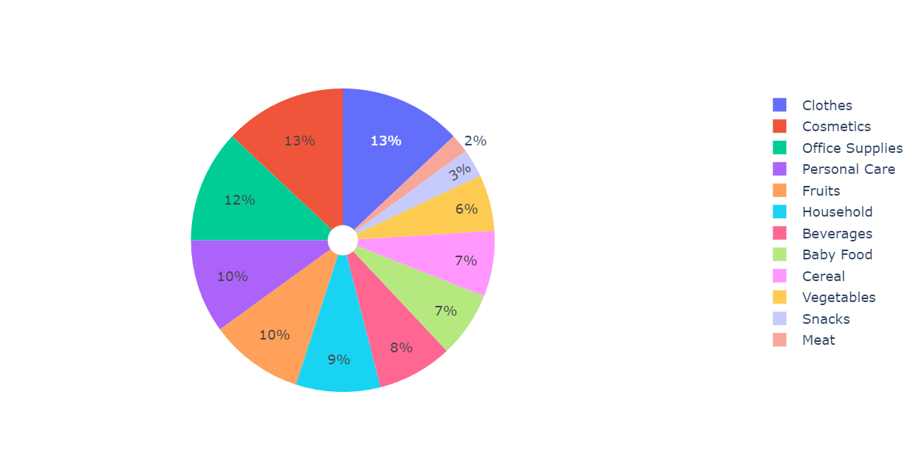
Distribution of Item Type

Slide 8
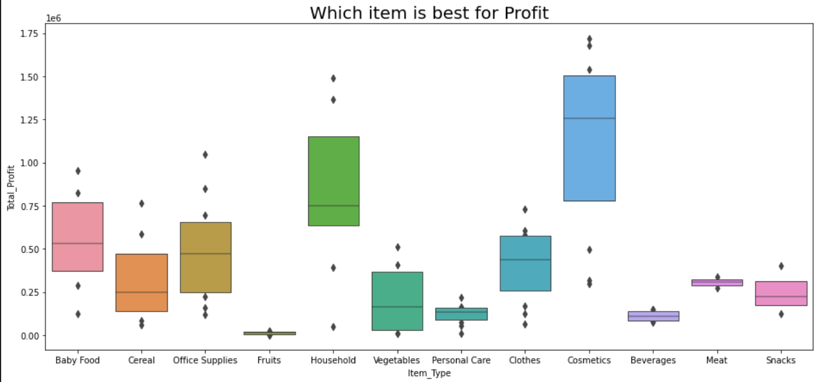
Which item is best for Profit

Slide 9
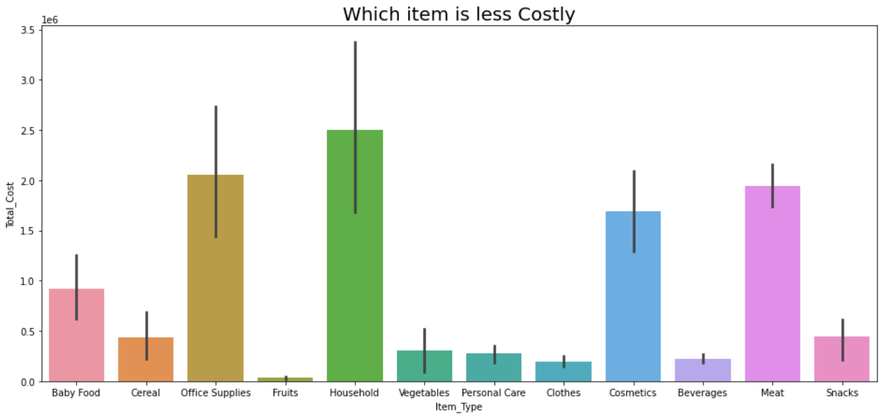

Slide 10
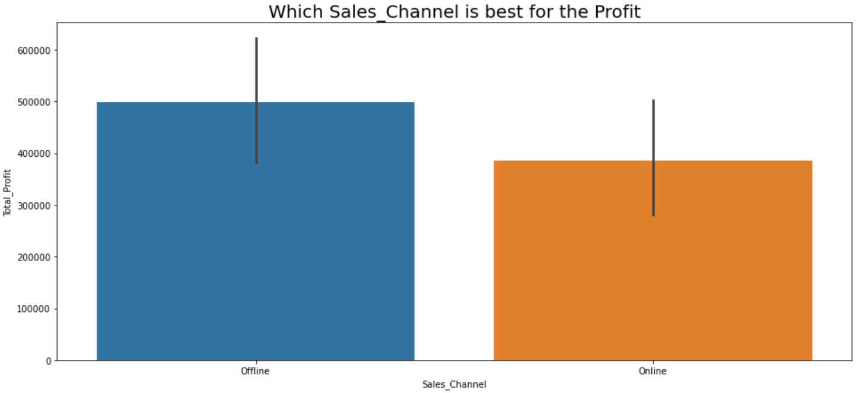
which Sales Channel is best for the Profit

Slide 11
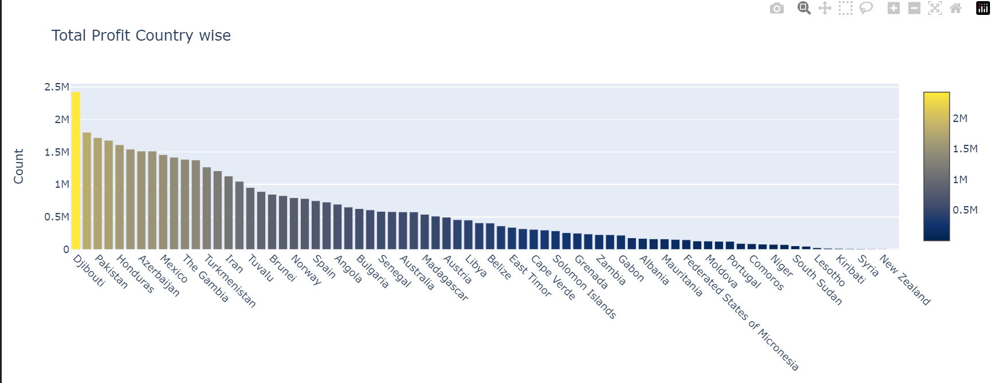
Total Profit country wise

Slide 12
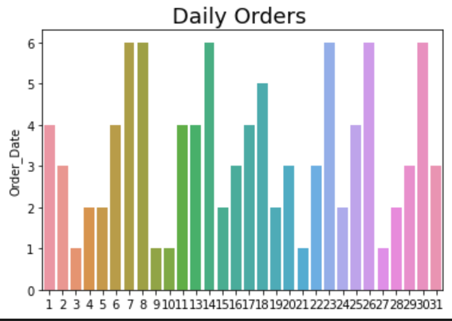
Daily orders

Slide 13
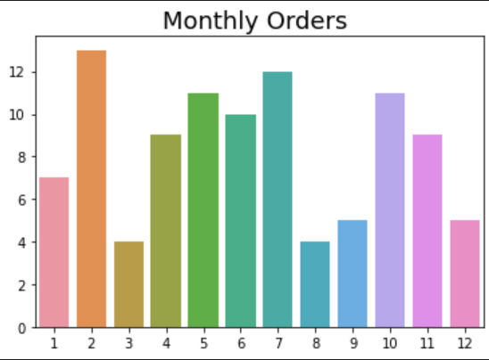
Monthly Orders

Slide 14
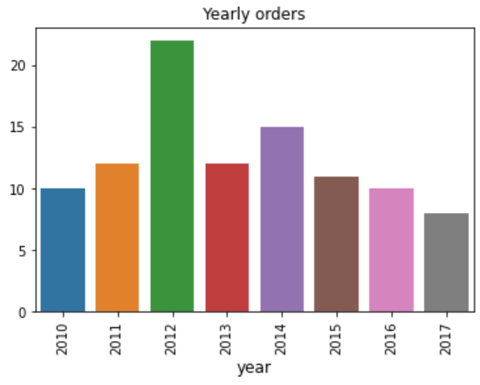
Yearly orders

Slide 15
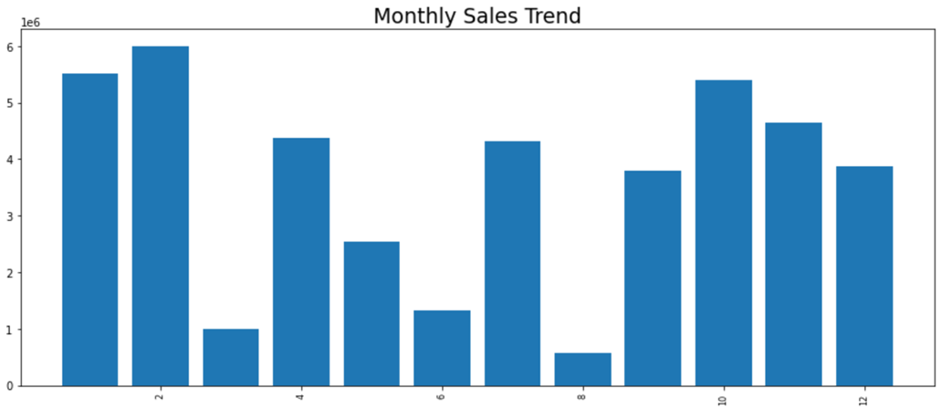
Monthly Sales Trends

Slide 16
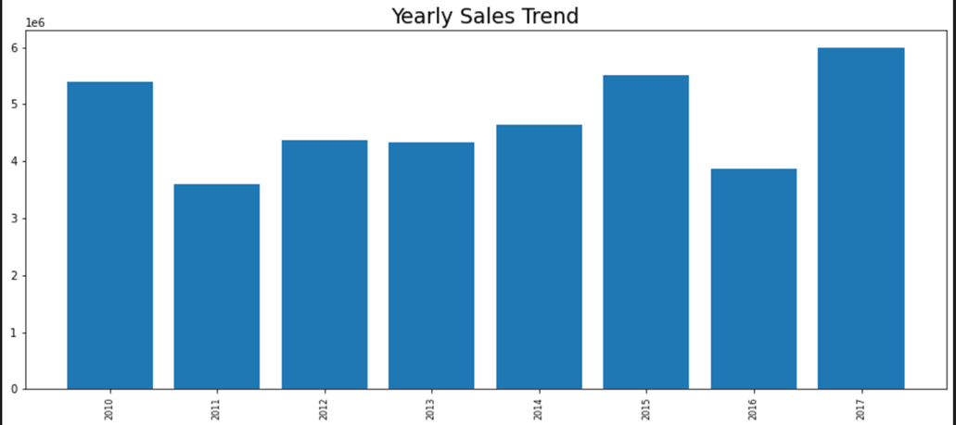
Yearly Sales Trend

Slide 17
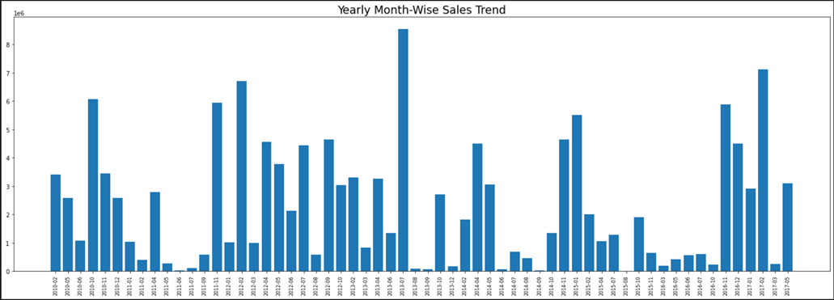
Yearly Month-Wise Sales Trend

Slide 18
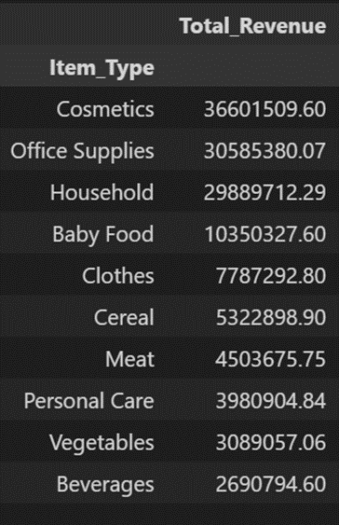
Total Revenue

Slide 19
QUESTIONSAND ANSWERS
Q1) What’s the source of data?
Ans) The Dataset is taken from iNeuron’s provided dataset
https://drive.google.com/drive/folders/1FkmFVL8wlJmQWP1z52TD8PlhOJhitTyI?usp=sharing
Q2) What was the type of data?
Ans) The data was a combination of numerical and Categorical values.
Q3) What was the complete flow you followed in this Project?
Ans) Refer slide 5th for better Understanding.
Q4) What techniques were you using fordata ?
Ans) -Removing unwanted attributes.
-Visualizing relationof independent variableswitheach other and output variables.
-Checking and changing distribution of continuous values.
-Removing outliers
-Cleaningdata and imputing ifnullvaluesare present.
-Transforming data to yield the desired result

Slide 20
THANK YOU

